Slide 1
Deep Learning Tools
Sungjoon Choi
Based on “CS231n: Convolutional Neural Networks for Visual Recognition”

Slide 2

Deep Learning Tools?
MatConvNet
Theano
TensorFlow
Torch
Caffe

Slide 3
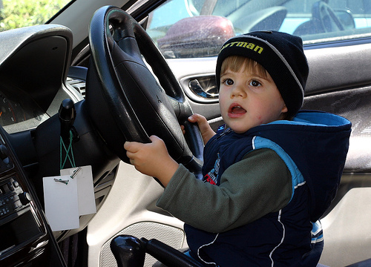
To tell the Truth..

Slide 4
Caffe
From U.C. Berkeley
Written in C++
Good for training or fine-tuning feedforward models

Slide 5
Caffe – Main Classes
Blobs: Store data and derivatives
Layer: Transform bottom blobs and top blobs
Net: Many layers; computes gradient via forward / backward
Solver: Uses gradients to update weights
Data (Layer)
W
InnerProduct (Layer)
SoftMax (Layer)
F
X
Y

Slide 6
Caffe – Pros & Cons
(+) Good for feedforward networks (CNN)
(+) Good for fine-tuning existing networks
(+) Train models without writing any code
(+) Python interface is pretty useful
(-) Need to write C++ / CUDA for new GPU layers
(-) Not good for recurrent networks
(-) Cumbersome for big networks (GoogLeNet, ResNet)

Slide 7
Torch
From NYU
Written in C and Lua
Used a lot in Facebook and DeepMind

Slide 8
Torch – Pros & Cons
(+) Easy to write your own layer types and run on GPU
(+) Many available library codes and packages
(+) Lots of pretrained models
(+) Lots of modular pieces that you can combine
(-) Lua
(-) Less plug-and-play than Caffe
(-) Not great for RNNs

Slide 9
Theano
From University of Montreal
Embracing computation graphs, symbolic computation
High-level wrappers: Keras, Lasagne

Slide 10
Theano – Pros & Cons
(+) Python + numpy
(+) Computational graph is cool
(+) Good for RNNs
(+) High level wrappers ease the pain
(-) Not enough pretrained models
(-) Error messages can be unhelpful
(-) Raw Theano is somewhat low-level

Slide 11
TensorFlow
From Google
Very similar to Theano
Easy visualizations
Multi-GPU and multi-node training

Slide 12
TensorFlow – Pros & Cons
(+) Python + numpy
(+) Computational graph is cool
(+) Much faster than Theano
(+) Easy to modify nets
(-) Not many pretrained model (but it will get better)
(-) Training time is slower than others right now
(-) Can hack into the networks

Slide 13
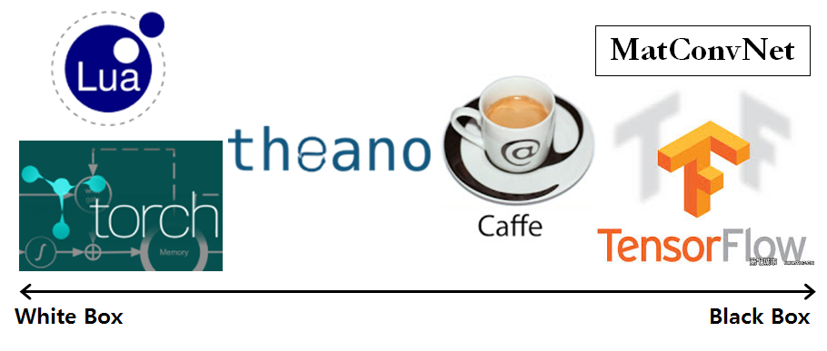
White or Black?

Slide 14
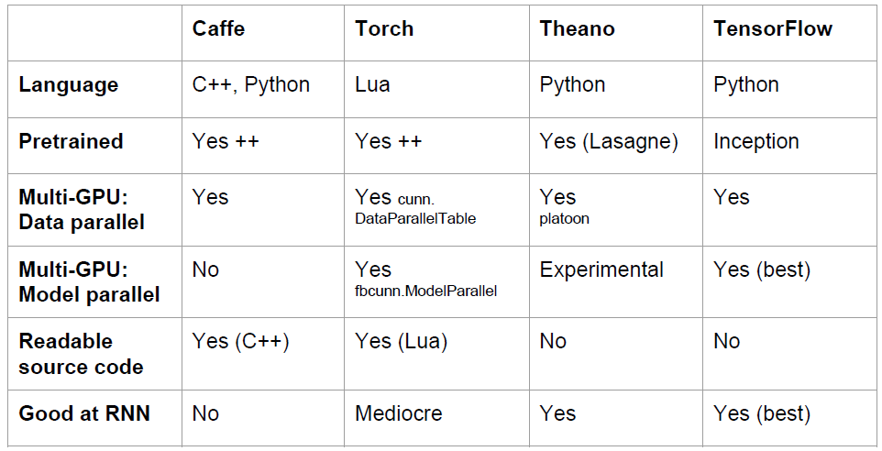
Overview

Slide 15
Karpathy’s Recommendation
Feature extraction / finetuning existing models: Use Caffe
Complex uses of pretrained models: Use Torch
Write your own layers: Use Torch
Crazy RNNs: Use Theano or TensorFlow
Huge model, need model parallelism: Use TensorFlow

